Slide 1

Population data analysis in Northern Europe
Pranav Coimbatore
Dept. of Statistics
George Mason University Fairfax, USA
.

Slide 2
Reasons and Research Questions
Reasons behind choosing the dataset
Research Questions
Data set was sourced from, The French Institute for Demographic Studies or INED, a public research institute specialized in population studies.
Analyzing population data can be viewed in two ways. One, it provides an instantaneous picture of a community as it was in any time.
The other aspect of analyzing population related data is to analyze the trend in population.
The questions a researcher could ask would be what factors influence the population estimates?
How does each variable in the dataset fare over each country?
What factors influence the total population estimates

Slide 3
Summary of Methods
Univariate analysis using scatterplots to understand the correlation between variables
Multiple linear regression to find out which variable had the highest influence on the total population estimates which is the response variable.
R were used for data cleaning, exploration and visualization
Choropleth maps were used to show the distribution of population and other variables in the dataset in each country.

Slide 4
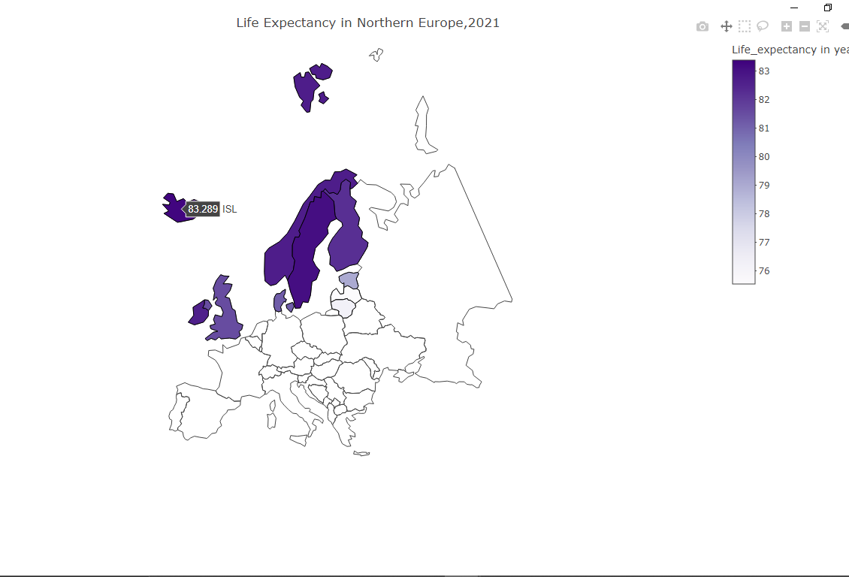
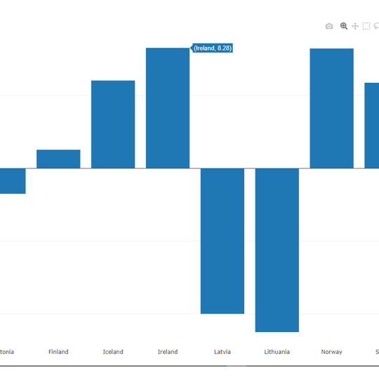
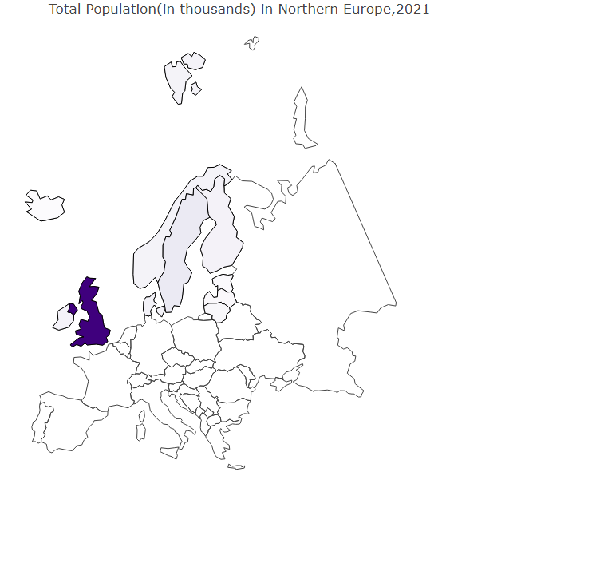
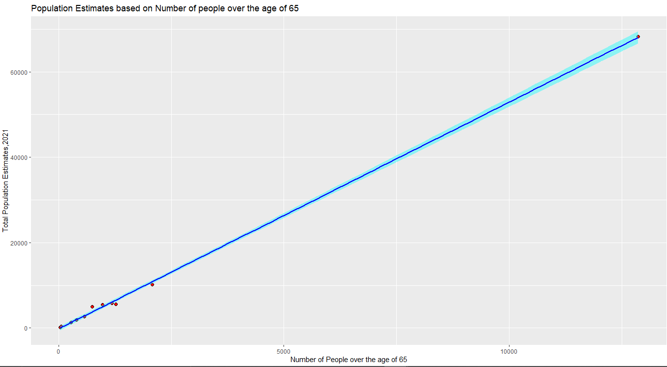
Summary of Findings
Iceland with the highest Life Expectancy
Bar chart showing growth rate in each country
United Kingdom appears to have the highest population estimate
The growth rate in each country as per the dataset can be visualized using a simple bar chart, Ireland shows the highest growth rate
The variable, number of people aged over 65 appeared to be the most influential variable, as shown in the scatter plot showing the relationship between the response and predictor variable
UK with the highest estimate
Scatter plot showing the relationship between response and predictor

Slide 5
Lessons Learned
The use of Choropleth maps to visualize spatial data
Using R for data analysis – Learned about various R packages to visualize data
Research methodology – The techniques used by other researchers, data analysis and visualization using R libraries
Multiple linear regression, interpreting the graphs and summary statistics from building models

